Slide 1
MENTAL ILLNESSES AND DISORDERS
Asoltanei Cristian
Bujoreanu Vlad
Gafita Andrei
Paduraru Andra

Slide 2
ANXIETY

Slide 3
Anxiety : What It Is?
A state of uncertainty and fear resulting from anticipation of a realistic or fantasized threatening event or situation, often impairing physical and psychological functioning.
Anxiety occurs when we behave in an apprehensive manner, such as when worrying about an event or situation.
BEHAVE = THINK + ACT
BEHAVIOUR is not caused by: biological, chemical, genetical problem with the brain.

Slide 4
ANXIETY = DISORDER
Anxiety : Mental Illness Or Disorder?
Unfortunately, the term mental illness is used to refer to any problem caused by behaving in an abnormal way (what is considered to be outside of the 'norm’).
All of us have behaviors that fall outside of the norm, which is why all of us could be categorized as having some type of mental illness.

Slide 5
DO/DID I HAVE ANXIETY?

Slide 6
Everyone experiences anxiety from time to time. This is normal. This is why anxiety is not a medical, biological, chemical, or genetic problem.
Anxiety VS Anxiety Disorder
A disorder is a disruption to normal functioning. Anxiety turns into disorder when anxiety and its sensations and symptoms interfere with a normal lifestyle.
If anxiety disorder isn't a medical, biological, chemical, or genetic problem, why does anxiety cause symptoms?

Slide 7
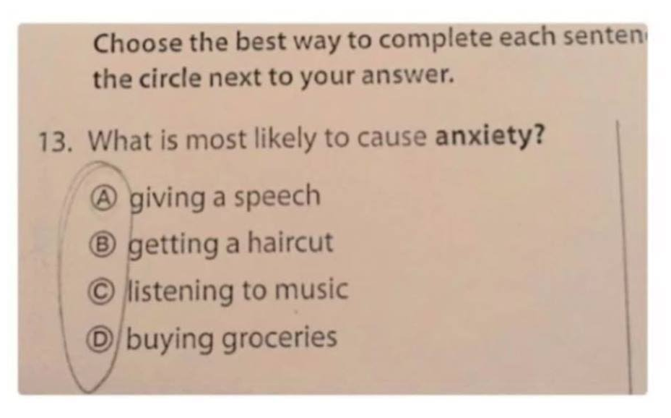
Symptoms
So anxiety symptoms are actually symptoms of stress. They are called anxiety symptoms because behaving apprehensively is the main source of the stress that overly stresses the body, which then, causes the body to exhibit symptoms.
Anxiety Disorder Symptoms = Anxiety Symptoms

Slide 8
How Do Men And Woman Experience This?
Because each body is chemically unique, the type, number, intensity, duration, and frequency of anxiety symptoms will vary from person to person. All combinations and variations are common.
The majority of anxiety symptoms in women and men are similar, but there are some anxiety symptoms differences.
This is all about how stress is affecting our body’s hormones, this is why women can experience stronger symptoms than men.

Slide 9
TYPES OF ANXIETY AND SYMPTOMS

Slide 10
Panic Attack Disorder (PAD)
Incredible amount of fear, trepidation, and foreboding, which is often accompanied by a strong urge to escape, a feeling that you are about to lose control, and for many, that they may even die
episodes of high intensity fear and anxiety
occur suddenly and 'out of the blue’
can occur without reason
just a few moments to hours
racing heart
lightheadedness
heart palpitations
sweating
nervous stomach
trembling
intense feeling of doom and gloom
feeling overwhelmed, like you are about to lose control, go crazy
sudden and strong urge to escape
heightened fear and apprehension
increased stimulation
pins and needles
throat tightness
muscle weakness
weak in the knees
super sensitive senses and nerves

Slide 11
Generalized Anxiety Disorder (GAD)
Generalized anxiety disorder doesn't mean your anxiety is worse than other types, but that you worry about more things and more often.
worry about many things
worry frequently
worry to a great degree
you haven't learned healthy ways of dealing with adversity, uncertainty, and risk
a general feeling of uneasiness
persistently being on alert for danger
persistent worry
an overly cautious approach to life
a persistent feeling of being unsafe
overly reactive to things that you perceive could be threatening
many of the physical, psychological, and emotional symptoms of anxiety

Slide 12
Obsessive Compulsive Disorder (OCD)
If you do a certain ritual enough times, you'll be safe
unwanted thoughts and actions that seem difficult to impossible to stop
can't stop worrying or something bad will happen
you haven’t learned to make yourself feel safe 'on the inside’
an example of an unhealthy coping style
relentless worry
underlying fear
an underlying sense of danger
inability to self-soothe
nervousness
agitation
sleep issues
and many of anxiety's physiological, psychological, and emotional symptoms

Slide 13
Social Anxiety Disorder (SAD)
Generally struggle with self-esteem and self-worth issues. Social phobia is another term often used to describe social anxiety.
overly anxious in social situations
afraid of what people might think of them and/or how those people might react
fear of rejection
nervousness around people who are deemed to be important
overly concerned about what people think
overly concerned about how people might react
hyper sensitive to rejection
overly sensitive to criticism
overly critical of others
and many of anxiety's physiological, psychological, and emotional symptoms

Slide 14
reoccurring memories, flashbacks, and nightmares that seem unstoppable
on going anxiety and worry
underlying fear and trepidation
persistently feeling unsafe and at risk
avoiding situations that remind you of the event
avoiding situations that are associated with reminders and the event itself
overly vigilant in uncertain situations
avoiding others
a persistent internal struggle
and many of anxiety's physiological, psychological, and emotional symptoms
Post Traumatic Stress Disorder (PTSD)
Some people say that having PTSD is similar to having panic attacks 24/7 and feeling there is nothing you can do to stop them.
uncontrollable anxious reactions and symptoms
strong anxious and distressing reactions to a past traumatic event
feel helpless to eliminate the negative memories, flashbacks, nightmares, night terrors and the strong reactions and symptoms that accompany them

Slide 15
Phobias
Extreme fears that seem unusually strong and encompassing.
fear of heights
fear of small spaces
fear of dogs
fear of snakes, spiders
fear of being trapped
overly afraid of a person, object, situation, or circumstance
heightened sense of danger near your feared subject
persistent worry and/or concern about your feared subject
and many of anxiety's physiological, psychological, and emotional symptoms

Slide 16
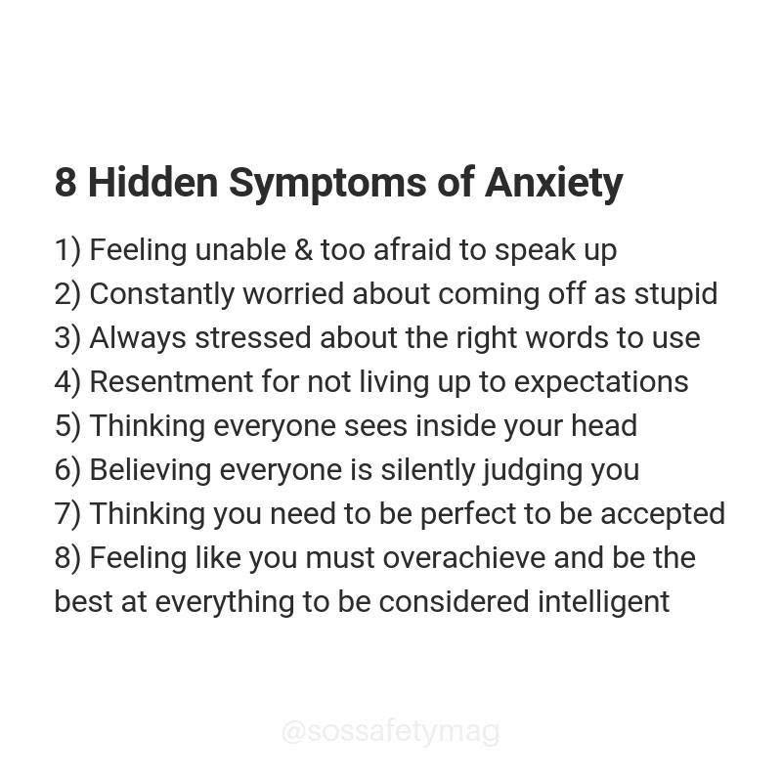

Slide 17
PROBLEMS PEOPLE MUST DEAL WITH

Slide 18
Decreased ability of doing daily basics
Can’t go to work/university/school
Not wanting to leave the house
Trying to avoid groups of people and closing yourself in
At least 1:30 people worldwide suffer from it. Women have doubled the risk to develop anxiety than men. Usually those who suffer from this often suffer from other mental health conditions. Depression goes alongside anxiety (they go hand in hand with each other).

Slide 19
ANXIETY LEADS TO WEIRD THINGS

Slide 20
Sweaty palms, nail biting, going back and forth in the room
Ice cold hands and feet (body enters in the fight mode trying to help you to survive)
Gas problems and frequent urination, eat and drink too quickly (muscle tense up)
Breath more rapidly than a normal person and as a result you yawn a lot (brain tricked for more oxygen)
Rashes on the skin (itches metaphorically and physically)
The need of space out, trouble concentrating (too overwhelming, everything seems unreal)
Hear phantom rings (anticipating events and having the feeling that is happening)
Strong attachments for those in relationships (even to family members)

Slide 21
Things People Do When They Have Anxiety
It is more than feeling nervous, excessive worry or fear…
They like to disappear without notice, no matter where they are, so they can recollect themselves.
They freak over the time it takes for someone to respond (over a message) and start thinking that it was actually something that they’ve said (“Was it rude or weird?”).
They tend to be perfectionists: check and recheck things over and over again.
They don’t often go to parties. It’s not that they are antisocial. They still want to have fun like everyone else but aren’t able because anxiety hits them.

Slide 22
They can remember traumatic events and certain days in detail, that leads to anxiety.
No matter where they are, they must do something (hold on to the phone or other objects everywhere they are).
They don’t make friends easily or not at all because they worry of making pression on people.
They tend to be overprotective and might be too clingy. In relationships they might feel the need to ask a lot of questions and try to talk a lot just to know how the other person is feeling.
They might be very confident at first but in the last minute they will cancel all the plans.
They will rehearse everything over and over again before making a phone call because they fear that they will make mistakes or forget what they have to say.
They will ask to be left alone when they want to calm down. This makes it harder for them to keep friends. It’s not about wanting to be alone forever but to have some time alone.

Slide 23
SOLUTIONS?

Slide 24
Are There Tests That Diagnose Anxiety?
A single test can’t diagnose anxiety. Instead, an anxiety diagnosis requires physical examinations, mental health evaluations, and psychological questionnaires.
Some doctors may conduct a physical exam, including blood or urine tests to rule out underlying medical conditions that could contribute to symptoms you’re experiencing.
Several anxiety tests and scales are also used to help your doctor assess the level of anxiety you’re experiencing.

Slide 25
What Treatment Is Available?
For some people, medical treatment isn’t necessary. Lifestyle changes may be enough to cope with the symptoms (diet changes, sport, eliminate unhealthy activities). But in severe cases pills or medication is needed.
Treatment for anxiety falls into two categories: psychotherapy and medication. Meeting with a therapist or psychologist can help you learn tools to use and strategies to cope with anxiety when it occurs.

Slide 26
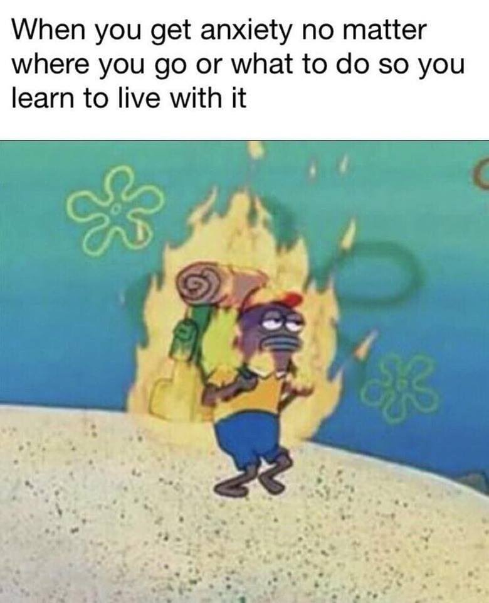
Some people who have a mild anxiety disorder, or a fear of something they can easily avoid, decide to live with the condition and to not seek treatment. Although, anxiety usually doesn’t go away, you can learn to manage it and live a happy, healthy life.

Slide 27
Depression

Slide 28
A clear definition:
"Major depressive disorder (MDD), also known simply as depression, is a mental disorder characterized by at least two weeks of low mood that is present across most situations. It is often accompanied by low self-esteem, loss of interest in normally enjoyable activities, low energy, and pain without a clear cause."

Slide 29
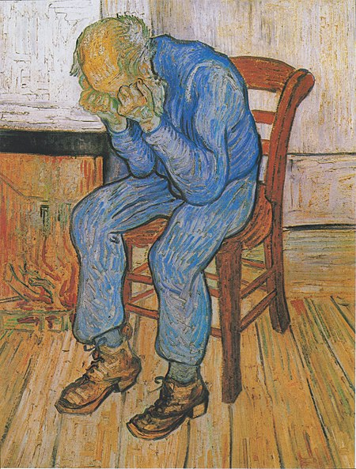
Worn Out: At Eternity's Gate
1890

Slide 30
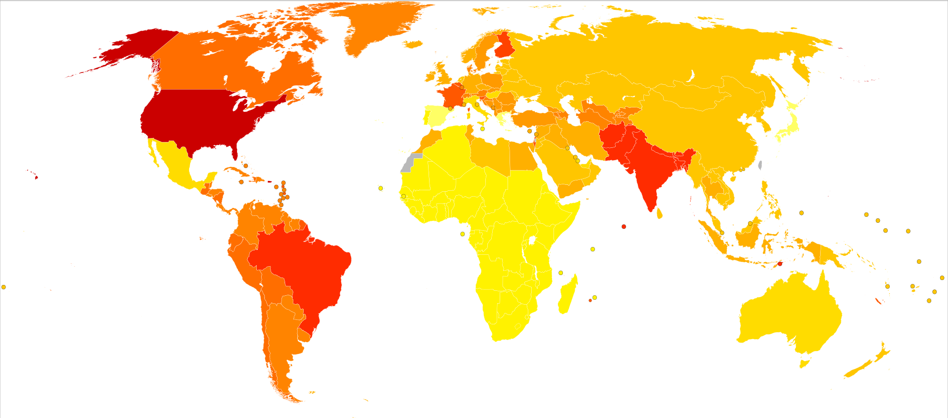
Epidemiology of depression:

Slide 31
Management of depression

Slide 32

Psychotherapy
There are a number of different psychotherapies for depression which are provided to individuals or groups by psychotherapists, psychiatrists, psychologists, clinical social workers, counselors or psychiatric nurses. With more chronic forms of depression, the most effective treatment is often considered to be a combination of medication and psychotherapy. Psychotherapy is the treatment of choice in people under 18.

Slide 33
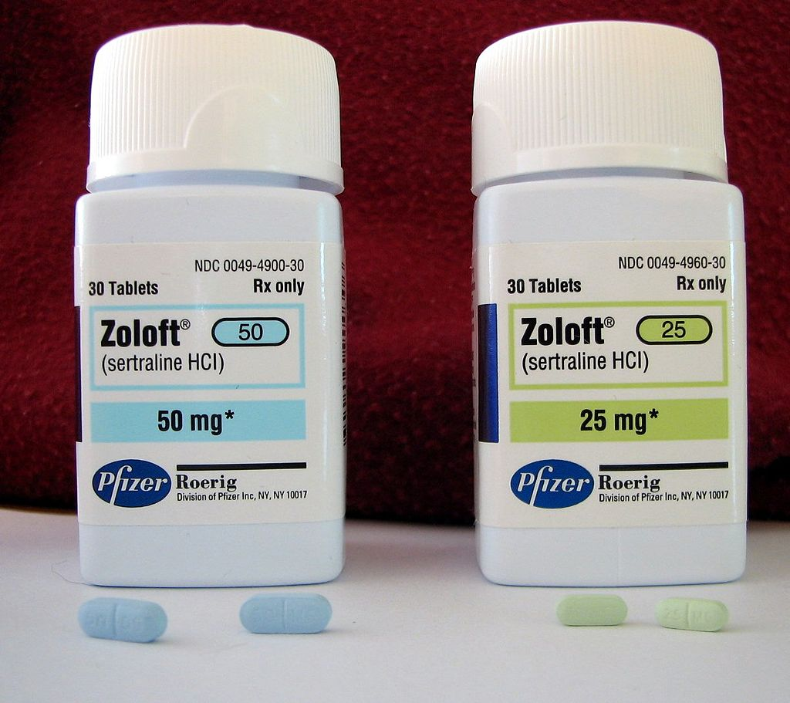
Medication
To find the most effective pharmaceutical drug treatment, the dosages of medications must often be adjusted, different combinations of antidepressants tried, or antidepressants changed. Response rates to the first agent administered may be as low as 50%. It may take anywhere from three to eight weeks after the start of medication before its therapeutic effects can be fully discovered. Patients are generally advised not to stop taking an antidepressant suddenly and to continue its use for at least four months to prevent the chance of recurrence.

Slide 34
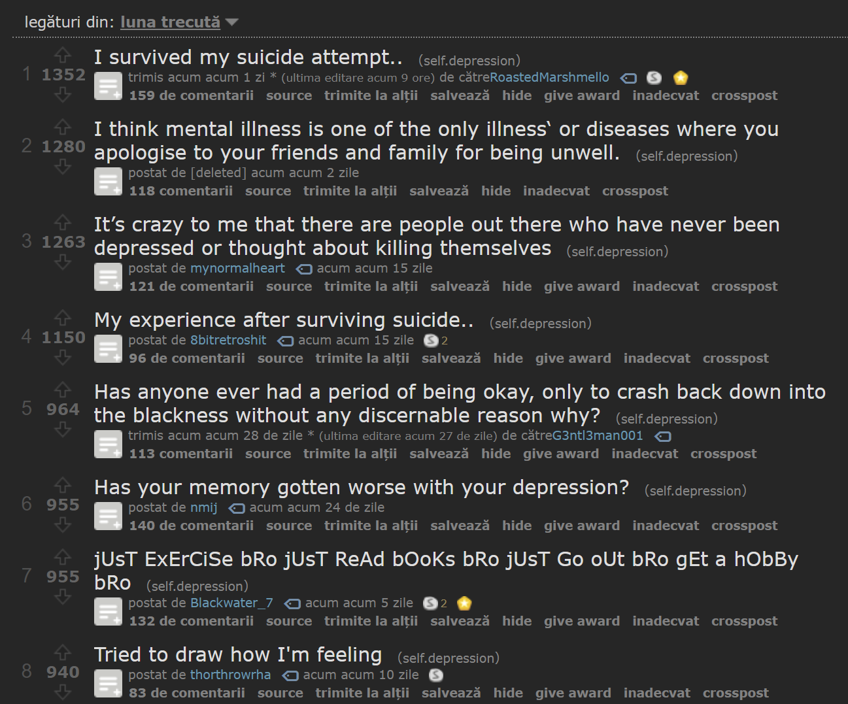

Slide 35
DELUSIONAL DISORDER

Slide 36
What is a delusion?
Unshakeable beliefs in something that isn’t true or based on reality
Non-bizzare delusions - situations that are not true at all or greatly exaggerated
Bizzare delusions – weird and most often a delusion that can’t be real at all
Can be a symptom to many mental disorders such as paranoia, schizophrenia etc.

Slide 37
Types of delusions
Erotomanic: The person believes someone is in love with them and might try to contact that person (might lead to stalking)
Grandiose: has an over-inflated sense of worth, power, knowledge, or identity. (special snowflakes)
Jealous: A person with this type believes their spouse or sexual partner is unfaithful.
Persecutory: Someone who believes that someone is spying on them or planning to harm them. They might make repeated complaints to legal authorities.
Somatic: They believe they have a physical defect or medical problem.
Mixed: These people have two or more of the types of delusions listed above.

Slide 38
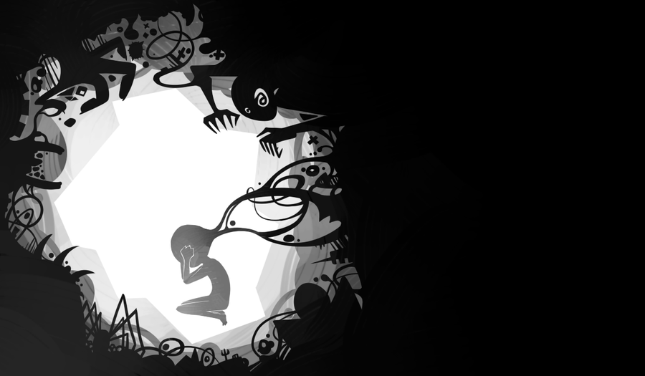
Symptoms
Non-bizzare illusions
Irritable
Angry
Low mood
Hallucinations related to the delusion.

Slide 39
Causes
Genetic: The fact that delusional disorder is more common in people who have family members with delusional disorder or schizophrenia suggests genes may be involved.
Biological: Researchers are studying how delusional disorders might happen when parts of the brain aren’t normal. (abnormal brain regions that control perception)
Environmental/psychological: Evidence suggests that stress can trigger delusional disorder. Alcohol and drug abuse also might contribute to it. People who tend to be isolated, such as immigrants or those with poor sight and hearing.

Slide 40
How is the disorder diagnosed?
The person should go to his/her doctor. The doctor will look for physical reasons for the symptoms.
Failing to find physical reasons results in the person being sent to a psychiatrist. The psychiatrist will interview the person as well as use assessment tools to determine if the person indeed has a mental condition.

Slide 41
Treatment
Conventional antipsychotics - They work by blocking dopamine receptors in the brain
Atypical antipsychotics - They work by blocking dopamine and serotonin receptors in the brain.
Other medications – antidepressants, tranquilizers etc.

Slide 42

PARANOIA

Slide 43
Symptoms
Doubt the commitment, loyalty, or trustworthiness of others, believing others are using or deceiving them
Are reluctant to reveal personal information due to a fear that the information will be used against them
Are hypersensitive and take criticism poorly
Read hidden meanings in the innocent remarks or casual looks of others
Perceive attacks on their character that are not apparent to others; they generally react with anger and are quick to retaliate
Have recurrent suspicions, without reason, that their spouses or lovers are being unfaithful
Have difficulty relaxing
Are hostile, stubborn, and argumentative

Slide 44
Causes
Genetic causes
Drugs
Head injuries
Social isolation
Stress
Traumatic events

Slide 45
Treatment
People with paranoia often do not seek treatment on their own because they do not see themselves as having a problem. When treatment is sought, psychotherapy(a form of counseling) is the treatment of choice for paranoia. Treatment likely will focus on increasing general coping skills, as well as on improving social interaction, communication, and self-esteem.
Because trust is an important factor of psychotherapy, treatment is challenging since people with paranoia have such distrust of others. As a result, many people with paranoia do not follow their treatment plan.
Medication generally is not a major focus of treatment for paranoia. However, medications, such as anti-anxiety, antidepressant or anti-psychotic drugs, might be prescribed if the person's symptoms are extreme, or if he or she also suffers from an associated psychological problem, such as anxiety or depression.

Slide 46
SCHIZOPHRENIA

Slide 47
What is Schizophrenia?
Schizophrenia is a mental disorder characterized by abnormal behavior, strange speech and a decreased ability to understand reality.

Slide 48
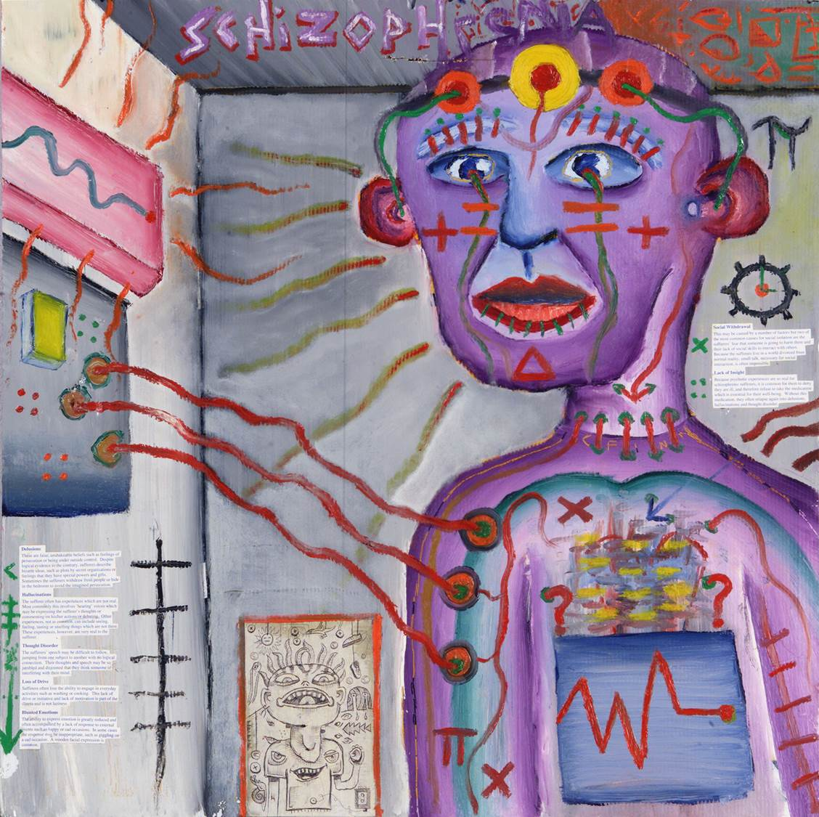
Symptoms
Hallucinations
Delusions
Negative symptoms:
Disorganized thinking and speech
Social withdrawal
Loss of motivation
Feeling judged
Artistic view of what the world feels like with schizophrenia

Slide 49


Slide 50
Causes
Genetics
Environment
Brain chemistry
Substance use

Slide 51
Treatment
Antipsychotic medication
Psychotherapy
Self-management strategies and education

Slide 52
HYPOCHONDRIA

Slide 53
What is Hypochondria?
Hypochondria is a condition in which a person is excessively and unduly worried about having a serious illness.

Slide 54
Symptoms
Intrusive thoughts
Compulsive checking of symptoms
Exaggerating every little symptom into thinking you have the biggest disease it can accompany

Slide 55
Causes
Social:
Articles, TV shows and advertisements regarding serious illnesses such as cancer and multiple sclerosis often portray these diseases as being random, obscure and somewhat inevitable.
Serious illnesses or deaths of family members or friends can trigger hypochondria in certain individuals.

Slide 56
Treatment
It usually goes hand in hand with anxiety or OCD, so the same treatment can be applied:
Psychotherapy
Limited range of psychotropic medication

Slide 57
Conclusion

